Slide 1
Spring WebFlux
CTO University Training

Slide 2
Table of contents
01 – Why WebFlux
02 – Architecture of Spring
applications
03 – Functional vs
Annotations
04 – Reactive REST server
05 – Processing the request
06 – Generating a response
07 – Error handlers
08 – Reactive WebClient
09 – Configuration
10 – WebFlux filters
11 – Input validation
12 – Logging
13 – Unit tests

Slide 3
01
Why Spring WebFlux?

Slide 4
Asynchronous platforms
Vertx.io (Eclipse)
http://vertx.io
Play
https://nodejs.org
Node.js
https://nodejs.org
Golang
https://golang.org
Spring WebFlux
https://spring.io

Slide 5
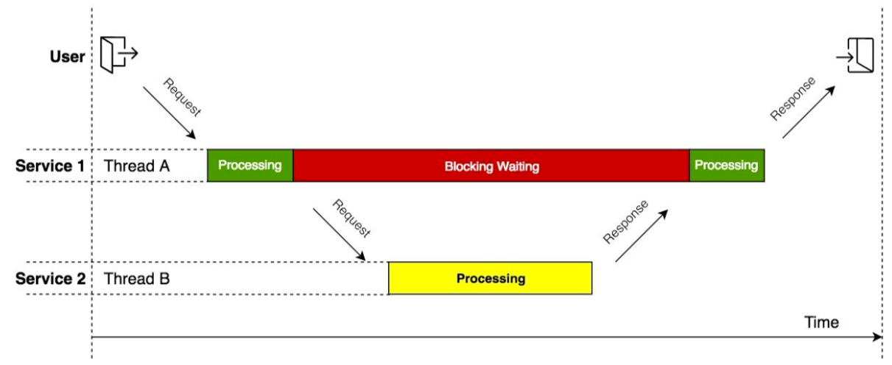
Blocking I/O

Slide 6
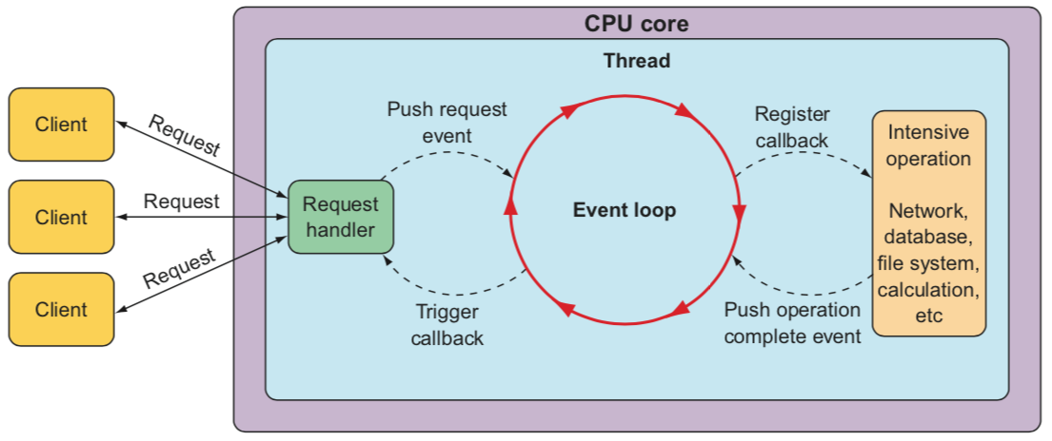
Asynchronous web frameworks
Event loop
Notes:
In an event loop, everything is handled as an event, including requests and callbacks from intensive operations like database and network operations. When a costly opera- tion is needed, the event loop registers a callback for that operation to be performed in parallel, while it moves on to handle other events.

Slide 7
Asynchronous web frameworks
Advantages
Higher scalability with fewer threads (usually one per CPU core)
Handle many requests per thread
Per-connection cost more economical

Slide 8
Spring WebFlux vs MVC

Slide 9
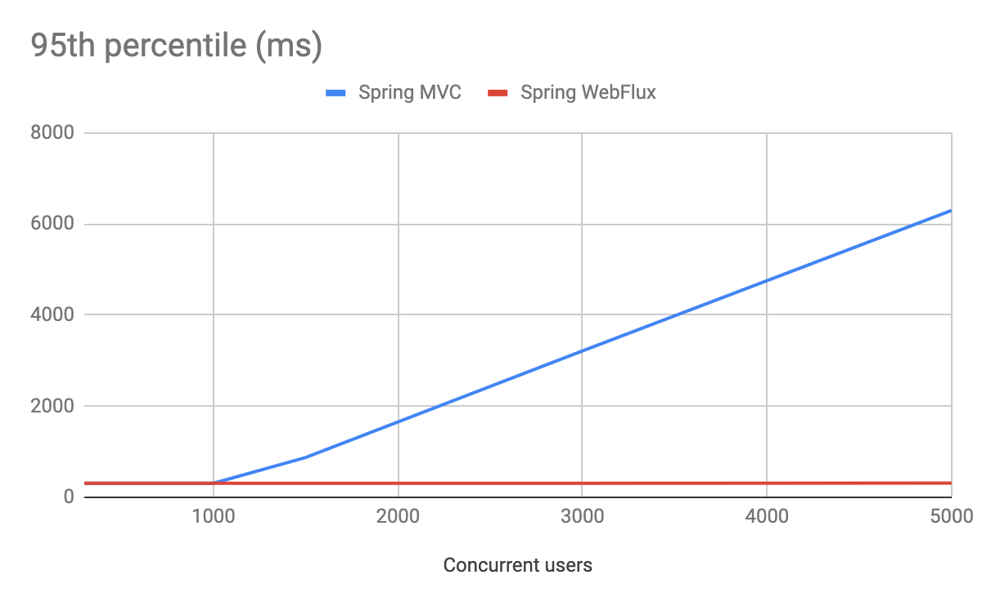
MVC vs WebFlux performance
Notes:
See https://dzone.com/articles/raw-performance-numbers-spring-boot-2-webflux-vs-s

Slide 10
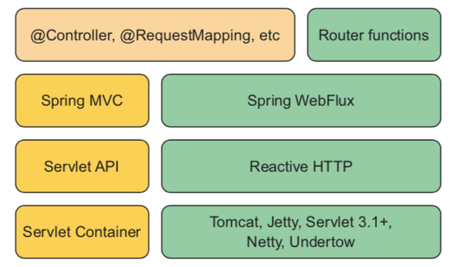
Spring MVC vs WebFlux
Spring Stacks
Notes:
Spring WebFlux can run on any non-blocking web container including Netty, Undertow, Tomcat, Jetty, or any Servlet 3.1 or higher container.
The default embedded server for WebFlux is Netty instead of Tomcat.
Aside from using a different starter dependency, Spring WebFlux controller meth- ods usually accept and return reactive types, like Mono and Flux, instead of domain types and collections. Spring WebFlux controllers can also deal with RxJava types like Observable, Single, and Completable.

Slide 11
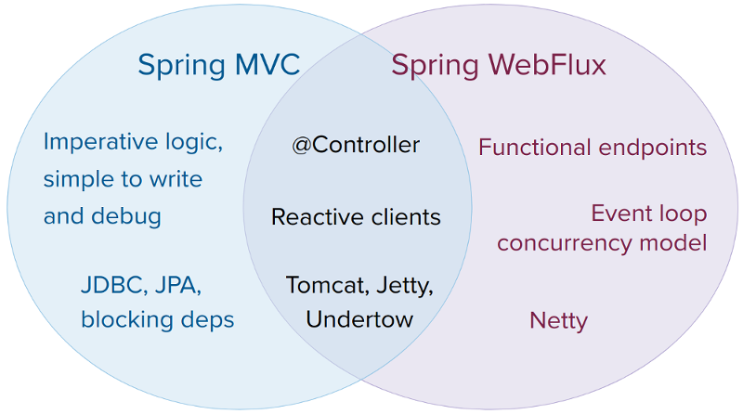
Spring MVC vs WebFlux

Slide 12
Reactive systems
Responsive (provide rapid and consistent response times)
Resilient (stays responsive in the face of failure)
Elastic (stays responsive under varying workload, react to changes, increase/decrease resources allocated)
Message driven (rely on asynchronous message-passing: loose-coupling, isolation, location transparent)

Slide 13
Reactive programming
Reactive programming is an asynchronous programming paradigm concerned with data streams and the propagation of change.
Wikipedia

Slide 14
Reactive world
Reactive
A software showing
responses to stimuli
Reactive
systems
Responsive
distributed
systems
Reactive
stream
Back-pressure
protocol
Reactive
programming
Asyncronous
development
model
Notes:
Back-pressure => Mechanism to ensure publishers don't overwhelm subscribers. A downstream can tell an upstream to send it fewer data in order to prevent it from being overwhelmed.

Slide 15
Reactive Java landscape
The Reactive Manifesto
https://www.reactivemanifesto.org
Reactive Streams
https://www.reactive-streams.org
JDK9 – Flow API
https://www.oracle.com
Reactor (Pivotal)
https://projectreactor.io
Vertx.io (Eclipse)
http://vertx.io
RxJava
http://reactivex.io
Spring 5
https://spring.io
Spring WebFlux
https://spring.io

Slide 16
Spring MVC vs WebFlux
When to choose MVC?
Imperative programming is the easiest way to write, understand, and debug code
Maximum choice of libraries
If you have blocking persistence APIs (JPA, JDBC)
Steep learning curve in the shift to WebFlux

Slide 17
Spring MVC vs WebFlux
When to choose WebFlux?
Scenario with high amount of concurrent requests
Looking for a non-blocking web stack in Java
Interested in a lightweight, functional web framework

Slide 18
02
Architecture of Spring applications

Slide 19
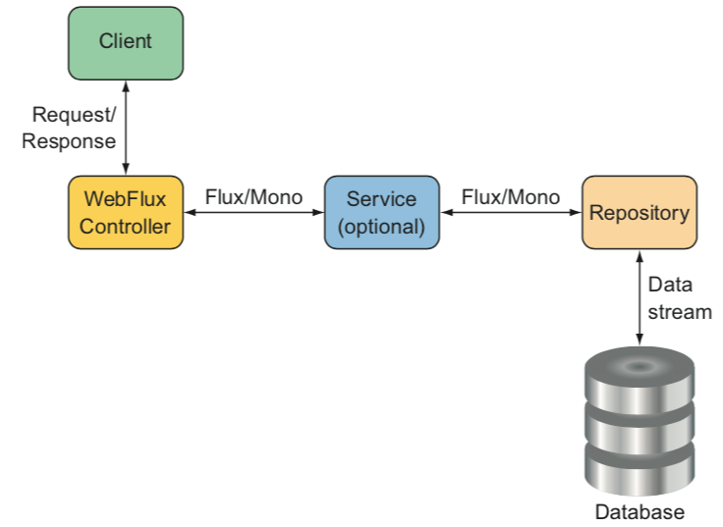
Component composition
Applications are the composition of components (beans)

Slide 20
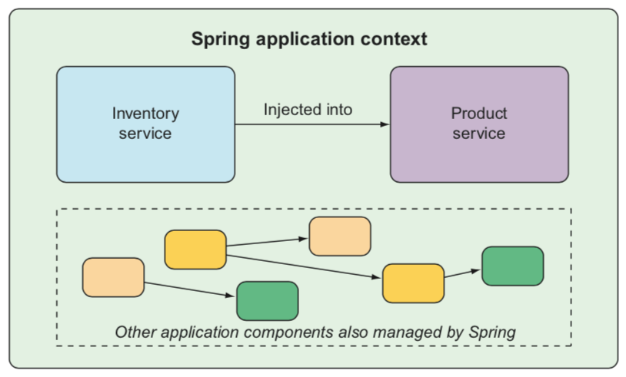
Spring application context
Spring application context
Container that creates and manages beans
Dependency injection (DI) to wire beans

Slide 21
Spring application context configuration
Explicit configuration:
XML configuration (traditional)
Java configuration
Implicit configuration:
Autowiring
Component scanning
Spring Boot autoconfiguration
Notes:
Spring in Action
---
Any non-trivial application is composed of many components, each responsible for its own piece of the overall application functionality, coordinating with the other application elements to get the job done. When the application is run, those compo- nents somehow need to be created and introduced to each other.
At its core, Spring offers a container, often referred to as the Spring application con- text, that creates and manages application components. These components, or beans, are wired together inside the Spring application context to make a complete application, much like bricks, mortar, timber, nails, plumbing, and wiring are bound together to make a house.
The act of wiring beans together is based on a pattern known as dependency injection (DI). Rather than have components create and maintain the lifecycle of other beans that they depend on, a dependency-injected application relies on a separate entity (the container) to create and maintain all components and inject those into the beans that need them. This is done typically through constructor arguments or property accessor methods.
On top of its core container, Spring and a full portfolio of related libraries offer a web framework, a variety of data persistence options, a security framework, integration with other systems, runtime monitoring, microservice support, a reactive pro- gramming model, and many other features necessary for modern application development.

Slide 22
Spring application context configuration
XML configuration
<bean id="inventoryService"
class="com.example.InventoryService" />
<bean id="productService"
class="com.example.ProductService" />
<constructor-arg ref="inventoryService" />
</bean>

Slide 23
Spring application context configuration
Java configuration
@Configuration
public class ServiceConfiguration {
@Bean
public InventoryService inventoryService() {
return new InventoryService();
}
@Bean
public ProductService productService() {
return new ProductService(inventoryService());
}
}
Notes:
https://stackoverflow.com/questions/10604298/spring-component-versus-bean
@Component (and @Service and @Repository) are used to auto-detect and auto-configure beans using classpath scanning. There's an implicit one-to-one mapping between the annotated class and the bean (i.e. one bean per class). Control of wiring is quite limited with this approach, since it's purely declarative.
@Bean is used to explicitly declare a single bean, rather than letting Spring do it automatically as above. It decouples the declaration of the bean from the class definition, and lets you create and configure beans exactly how you choose.

Slide 24
Spring application context configuration
Implicit configuration
Component scanning
Spring automatically discovers components from an application’s classpath and create them as beans in the Spring application context
Autowiring
Spring automatically injects the components with the other beans that they depend on

Slide 25
Application bootstrap
@SpringBootApplication
public class MyApplication {
public static void main(String[] args) {
SpringApplication.run(MyApplication.class, args);
}
}
Notes:
The main() method calls a static run() method on the SpringApplication class, which performs the actual bootstrapping of the application, creating the Spring application context.

Slide 26
Application bootstrap
@SpringBootApplication
Composite annotation:
@SpringBootConfiguration
@EnableAutoConfiguration
@ComponentScan
Notes:
@SpringBootConfiguration
Specialized form of the @Configuration annotation
@EnableAutoConfiguration
Enables Spring Boot automatic configuration
@ComponentScan
Enables component scanning.
Classes registered with @Component, @Controller, @Service, and others will be registered as beans

Slide 27
03
Functional vs Annotations

Slide 28
Programming models
Annotated controllers
Functional endpoints
Consistent with Spring MVC
More readable
Based on annotations
WebFlux specific
Less readable
Lambda-based, lightweight, and functional programming model
@RestController
@RequestMapping("/books")
public class HelloController {
@GetMapping("/{id}")
public Book getBook(long id) {…}
}
@Bean
RouterFunction<ServerResponse> getBookByIdRoute() {
return route(GET("/{id}"),
req -> ok().body(…));
}

Slide 29
Annotated controllers
@Controller vs @RestController
@Controller
@RestController
Targets web applications (HTML, CSS, js)
Specialization of @Component
Annotates a class responsible for preparing a model map to be displayed by a view.
Targets REST APIs
Combination of @Controller and @ResponseBody
@ResponseBody serializes the domain object in the HTTP response
@RestController
@RequestMapping("/books")
public class HelloController {
@GetMapping("/{id}")
public Book getBook(long id) {…}
}

Slide 30
HandlerFunction
HandlerFunction generates a response (ServerResponse) for a request (ServerRequest).
HandlerFunction
ServerRequest
Mono<ServerResponse>
@FunctionalInterface
public interface HandlerFunction<T extends ServerResponse> {
Mono<T> handle(ServerRequest request);
}

Slide 31
HandlerFunction
HandlerFunction is less readable
It is recommended to group related handlers into a controller class.
public class HelloController {
public Mono<ServerResponse> hello(ServerRequest request) {
return ServerResponse.ok()
.body(BodyInserters.fromObject("Hello world"));
}
}

Slide 32
RouterFunction
Routes an incoming request to a HandlerFunction
Alternative to @RequestMapping
Can be composed
RouterFunction
ServerRequest
Mono<HandlerFunction>
@FunctionalInterface
public interface RouterFunction<T extends ServerResponse> {
Mono<HandlerFunction<T>> route(ServerRequest request);
}

Slide 33
RouterFunction
RouterFunctions.route() is a helper function to create routes
When the RequestPredicate is matched, then the second argument (HandlerFunction) is returned.
HelloController helloController = new HelloController();
ProjectsController projectsController = new ProjectsController();
RouterFunction<ServerResponse> helloRoute =
route(GET("/hello"), helloController::hello)
.andRoute(POST("/projects").and(contentType(APPLICATION_JSON)), projectsController::create);

Slide 34
04
Reactive REST server

Slide 35
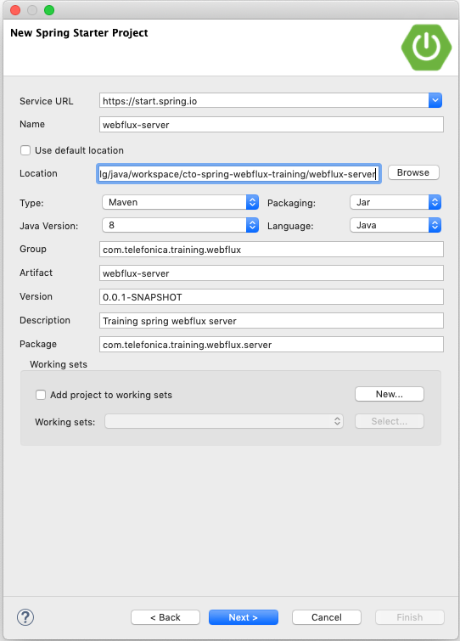
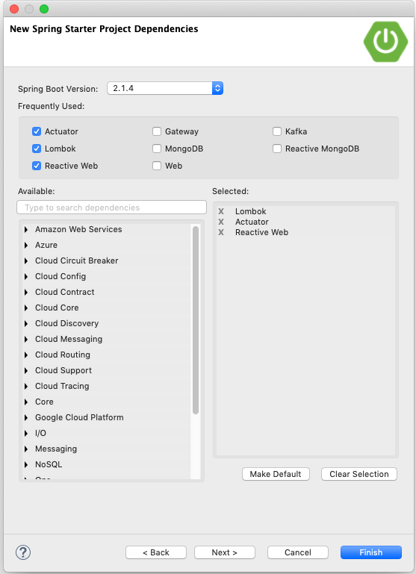
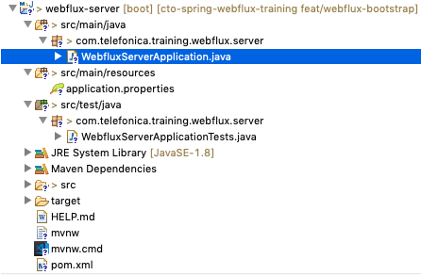
Practice wf01
Create project with Spring Starter

Slide 36
Practice wf01
Create Hello World API
package com.telefonica.training.webflux.server.controllers;
import org.springframework.web.bind.annotation.GetMapping;
import org.springframework.web.bind.annotation.RestController;
@RestController
public class HelloController {
@GetMapping("/hello")
public String hello() {
return "hello world";
}
}
Notes:
this class is annotated with @RestController for component scanning

Slide 37
05
Processing the request

Slide 38
@RequestMapping
@RequestMapping maps a request to a Controller method
The Controller class can also be annotated with @RequestMapping.
Multiple criteria: path, method, header, query parameter

Slide 39
@RequestMapping
By HTTP method (required)
@RequestMapping(method = RequestMethod.GET)
public String hello() {
return "Hello world";
}
By HTTP method with shortcuts
@GetMapping
public String hello() {
return "Hello world";
}

Slide 40
@RequestMapping
By path
@GetMapping(value = "/hello")
public String hello() {
return "Hello world";
}
By header
@GetMapping(value = "/hello", headers = "x-debug=true")
public String hello() {
return "Hello world";
}

Slide 41
@RequestMapping
By media type:
With produces:
@GetMapping(value = "/hello", produces = MediaType.APPLICATION_JSON)
public String hello() {
return "Hello world";
}
With consumes:
@PostMapping(value = "/books", consumes = MediaType.APPLICATION_JSON)
public Mono<Book> insertBook(@RequestBody Book book) {
return Mono.just(book);
}

Slide 42
@RequestMapping
By media type:
Multiple values are supported:
@GetMapping(value = "/hello",
produces = { MediaType.APPLICATION_JSON, MediaType.APPLICATION_XML })
public String hello() {
return "Hello world";
}
This method level annotation does not complement but override the class level annotation.

Slide 43
@RequestMapping
With path variables:
@GetMapping(value = "/books/{id}", produces = MediaType.APPLICATION_JSON)
public Mono<Book> getBook(@PathVariable long id) {
return Mono.just(new Book().setId(id));
}
Regex compliant:
@GetMapping(value = "/books/{id:[\\d]+}")
public Mono<Book> getBook(@PathVariable long id) {
return Mono.just(new Book().setId(id));
}

Slide 44
@RequestMapping
With query parameters:
Passing the query parameter to the handler
@GetMapping(value = "/books")
public Flux<Book> getBooksByAuthor(@RequestParam("author") String author) {
return Flux.just(…);
}
Passing an optional query parameter
@GetMapping(value = "/books")
public Flux<Book> getBooksByAuthor(
@RequestParam(value = "author", required = false) String author) {
return Flux.just(…);
}

Slide 45
@RequestMapping
With query parameters:
Matching a query parameter value:
@GetMapping(value = "/books", params="paged=true")
public Flux<Book> getBooksWithPagination() {
return Flux.just(…);
}
Forcing existence of query parameter
@GetMapping(value = "/books", params="paged")
public Flux<Book> getBooksWithPagination() {
return Flux.just(…);
}

Slide 46
@RequestMapping
Fallback
@GetMapping(value = "*")
public String getFallback() {
return "Fallback response for GET requests";
}

Slide 47
@RequestBody
@RequestBody annotation decodes the HTTP request body into a domain object.
Deserialization is performed by a converter according to the content type.
@PostMapping(value = "/books", consumes = MediaType.APPLICATION_JSON)
public Mono<Book> insertBook(@RequestBody Book book) {
return Mono.just(book);
}

Slide 48
Practice wf02
Goal
Implement the following request:
GET /api/projects/1
It should return a fake Project object.
See openapi: https://github.com/Telefonica/cto-spring-webflux-training/blob/master/webflux-server/doc/openapi.yaml

Slide 49
Practice wf02
Create a domain object
package com.telefonica.training.webflux.server.domain;
import java.util.List;
import lombok.Data;
import lombok.experimental.Accessors;
@Data
@Accessors(chain=true)
public class Project {
private Long id;
private String name;
private String organization;
private String githubToken;
private List<String> repositories;
}

Slide 50
Practice wf03
Goal
Build a standard Spring application with controller, service and repository.
ProjectsController
HTTP interaction
ProjectsService
Business logic
ProjectsRepository
Database
The repository is an in-memory database (to be replaced by MongoDB later on)

Slide 51
@ResponseBody
Create a controller for projects API
package com.telefonica.training.webflux.server.controllers;
@RestController
@RequestMapping(...)
public class ProjectsController {
private final ProjectsService projectsService;
public ProjectsController(ProjectsService projectsService) {
this.projectsService = projectsService;
}
@GetMapping(...)
public Mono<Project> getProject(@PathVariable long projectId) {
return this.projectsService.getProject(projectId);
}
}

Slide 52
Practice wf04
Goal
Add API resource to insert a new Project.
POST /api/projects
Tip (for ProjectsService):
Get new project ID: projectsRepository.next()
Set the project ID to the Project object
Store the project in the repository: projectsRepository.save()
Return the Project object (including the project ID)

Slide 53
06
Generating a response

Slide 54
@ResponseBody
@ResponseBody annotation encodes the domain object returned by the controller handler into a HTTP response body.
Serialization is performed by a converter according to the content type.
The annotation is implicit with @RestController.
Spring handles reactive and non-reactive objects.

Slide 55
@ResponseBody
Return domain objects
Serialize domain object according to "produces" media type (default "application/json")
Only specifies the response body (no status code or headers).
@GetMapping("/books/{id}")
public Mono<Book> getBook(@PathVariable long bookId) {
Book book = new Book();
return Mono.just(book);
}

Slide 56
ResponseEntity
Configure the full HTTP response: status code, headers and body.
Generic type with the domain type for the response body.
@PostMapping("/books")
public Mono<ResponseEntity<Book>> createBook(@BodyRequest Book book) {
URI locationUri = new UriTemplate("/books/{bookId}").expand(1L);
ResponseEntity<Book> re = ResponseEntity.created(locationUri).body(book);
return Mono.just(re);
}

Slide 57
Practice wf05
Goal
Complete the projects API:
findProjects: GET /api/projects
updateProject: PUT /api/projects/{projectId}
deleteProject: DELETE /api/projects/{projectId}

Slide 58
Streaming
Flux response can be sent as Server-Sent Events (SSE).
SSE is delivered with Content-Type text/event-stream.
Each event is sent with a prefix "data:" and a suffix "\n\n"
@GetMapping(value = "/books", produces = MediaType.TEXT_EVENT_STREAM_VALUE)
public Flux<Book> findBooks() {
return Flux.just(…);
}

Slide 59
07
Error handlers

Slide 60
Handling errors
Application Specific
Very cumbersome and repetitive
Controller is more complex to handle all the errors and generate the appropriate response.
Controller level
@ControllerAdvice
Easy way to handle all the errors generated by a controller.
Does not handle RequestMapping errors, web filter errors, …
Global level
Easiest way to handle all the errors of the platform.

Slide 61
Handling errors
Application specific
@GetMapping("/{projectId}")
public Mono<ResponseEntity<Project>> getProject(@PathVariable long projectId) {
return projectsService.getProject(projectId)
.map(project -> ResponseEntity.ok().body(project))
.switchIfEmpty(Mono.just(ResponseEntity.notFound().build()));
}

Slide 62
Handling errors
Controller level (@ControllerAdvice)
@ControllerAdvice may be applied to a set of controllers (or all of them by default).
@ExceptionHandler specifies the exception type to be managed
@ControllerAdvice
public class ErrorControllerAdvice {
@ExceptionHandler(MyException.class)
public ResponseEntity<?> responseStatusException(MyException e) {
return ResponseEntity.status(HttpStatus.BAD_REQUEST)
.body(new ServerError("my-exception", e.getMessage()));
}
}

Slide 63
Practice wf06
Goal
Add ControllerAdvice for:
NotFoundException. Only return the status code 404.
ResponseStatusException. Return a response with status and error description provided by the exception.

Slide 64
Handling error
Global level
@Component
@Order(-2)
public class ErrorWebExceptionHandler extends AbstractErrorWebExceptionHandler {
public ErrorWebExceptionHandler(ErrorAttributes errorAttributes,
ResourceProperties resourceProperties, ApplicationContext applicationContext,
ServerCodecConfigurer serverCodecConfigurer) {
super(errorAttributes, resourceProperties, applicationContext);
super.setMessageWriters(serverCodecConfigurer.getWriters());
super.setMessageReaders(serverCodecConfigurer.getReaders());
}
@Override
protected RouterFunction<ServerResponse> getRoutingFunction(ErrorAttributes errorAttributes) {
return RouterFunctions.route(RequestPredicates.all(), this::renderServerResponse);
}
protected Mono<ServerResponse> renderServerResponse(ServerRequest request) {...}
}

Slide 65
Practice wf07
Goal
Add global error handler.
Refactor custom exceptions to inherit from Exception class with information to generate the error response.

Slide 66
08
Reactive WebClient

Slide 67
WebClient
Non-blocking and reactive alternative to RestTemplate
Exposes reactive ClientHttpRequest and ClientHttpResponse
Body of the request and response is a Flux<DataBuffer>

Slide 68
WebClient
WebClient client = WebClient.create("http://example.com");
Mono<Account> account = client.get()
.uri("/accounts/{id}", 1L)
.accept(MediaType.APPLICATION_JSON)
.exchange()
.then(response -> response.bodyToMono(Account.class));
Notes:
https://www.slideshare.net/gal.marder/whats-expected-in-spring-5

Slide 69
WebClient
Create WebClient instance
With create:
With builder:
WebClient webClient = WebClient.create("http://example.com");
WebClient webClient = WebClient.builder()
.baseUrl("http://example.com")
.defaultCookie("cookieKey", "cookieValue")
.defaultHeader(HttpHeaders.CONTENT_TYPE, MediaType.APPLICATION_JSON_VALUE)
.build();

Slide 70
WebClient
Prepare the request
Book book = new Book();
webClient.post()
.uri("/books")
.accept(MediaType.APPLICATION_JSON)
.header(HttpHeaders.CONTENT_TYPE, MediaType.APPLICATION_JSON_VALUE)
.body(BodyInserters.fromObject(book));
BodyInserters is an interface to add the request body from a domain object.

Slide 71
WebClient
Get the response
retrieve() is the shortest path to get the response body
Mono<String> responseBody = webClient.post()
.retrieve()
.bodyToMono(String.class);
bodyToMono throws a WebClientException if the status code is an error (4xx or 5xx).

Slide 72
WebClient
Get the response
exchange() provides a ClientResponse (with status, headers, and response body)
Mono<ClientResponse> clientResponse = webClient.post()
.exchange();
Mono<HttpStatus> statusCode = clientResponse.map(clientResponse ->
clientResponse.statusCode();
Mono<Book> book = clientResponse.bodyToMono(Book.class);

Slide 73
Practice wf08
Goal
Build a WebClient to access github API to extract stats of languages of a repo:
GET https://api.github.com/repos/{org}/{repo}/languages
Implement new Controller to get the information of a project's controller (with languages stats):
GET /api/projects/{projectId}/repos/{repo}

Slide 74
09
Configuration

Slide 75
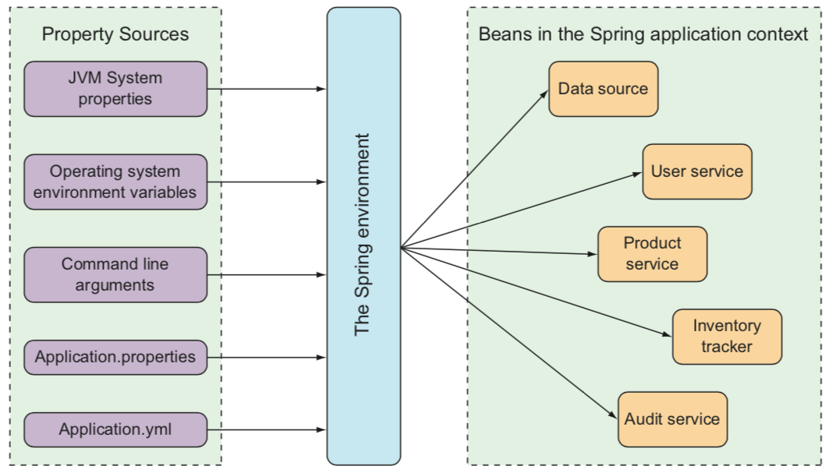
Spring configuration

Slide 76
Spring configuration
Example - Server port configuration
src/main/resources/application.properties
src/main/resources/application.yml
server.port=9090
server:
port: 9090
Environment variable
Command-line argument
export SERVER_PORT=9090
java -jar myapp-0.0.5-SNAPSHOT.jar \
--server.port=9090

Slide 77
Spring configuration
Special property values
Using placeholder ${}:
to other properties:
environment variables with default value:
greeting:
msg: You are using ${spring.application.name}.
greeting:
msg: ${GREETING_MSG:You are using myapp}
Notes:
What is the spring-boot-configuration-processor ? Why do people exclude libraries from it? Why is it invisible in dependency tree?
https://www.baeldung.com/configuration-properties-in-spring-boot

Slide 78
Spring configuration
Metadata for custom properties
src/main/resources/META-INF/ additional-spring-configuration-metadata.json
{
"properties": [
{
"name": "greeting.msg",
"type": "java.lang.String",
"description": "greeting message"
}
]
}

Slide 79
Practice wf09
Goal
Configure the URL for the github WebClient
Add the configuration metadata

Slide 80
Spring profiles
Profiles are a type of conditional configuration where different beans, configuration classes, and configuration properties are applied or ignored based on what profiles are active at runtime
Convention:
application-{profile_name}.properties
application-{profile_name}.yml

Slide 81
Spring profiles
Activating Spring profiles
Activating a profile:
Activating multiple profiles:
export SPRING_PROFILES_ACTIVE=prod
export SPRING_PROFILES_ACTIVE=prod,audit,ha

Slide 82
Spring profiles
Conditional beans with profiles
Load MyBean only with "dev" profile:
Other options:
@Bean
@Profile("dev")
public MyBean myBean() {…}
@Profile({"dev", "int"})
@Profile("!prod")

Slide 83
10
WebFlux filters

Slide 84
WebFilters
Intercepts requests to apply cross-cutting requirements (security, timeouts, …)
public interface WebFilter {
/**
* Process the Web request and (optionally) delegate to the next
* {@code WebFilter} through the given {@link WebFilterChain}.
* @param exchange the current server exchange
* @param chain provides a way to delegate to the next filter
* @return {@code Mono<Void>} to indicate when request processing is complete
*/
Mono<Void> filter(ServerWebExchange exchange, WebFilterChain chain);
}

Slide 85
Practice wf10
Goal
WebFilter for base path "/api"
public Mono<Void> filter(
ServerWebExchange exchange, WebFilterChain chain) {
ServerHttpRequest request = exchange.getRequest()
.mutate()
.contextPath(basePath)
.build();
return chain.filter(
exchange.mutate().request(request).build());
}

Slide 86
Practice wf11
Goal
WebFilter to compose the Location HTTP header
public Mono<Void> filter(ServerWebExchange exchange, WebFilterChain chain) {
exchange.getResponse().beforeCommit(() -> {
HttpHeaders httpHeaders = exchange.getResponse().getHeaders();
if (httpHeaders.getLocation() != null) {
URI uriLocation = new UriTemplate("{requestUri}/{locationUri}")
.expand(exchange.getRequest().getURI(), httpHeaders.getLocation());
httpHeaders.setLocation(uriLocation);
}
return Mono.empty();
});
return chain.filter(exchange);
}

Slide 87
Reactor context
Reactor Context is an interface that is passed along the stream.
It aims to provide contextual information that may be useful to access later at runtime phase.
Alternative to ThreadLocal

Slide 88
Reactor context
Manage the reactive context
Create the context
Read the context:
RequestContext requestContext = buildRequestContext(request);
return chain.filter(exchange)
.subscriberContext(Context.of(RequestContext.class, requestContext));
Mono.subscriberContext()
.map(ctxt -> ctxt.get(RequestContext.class))

Slide 89
Practice wf12
Goal
WebClient WebFilter to send a correlator header
private static ExchangeFilterFunction addCorrelatorHeader() {
return ExchangeFilterFunction.ofRequestProcessor(request ->
Mono.subscriberContext()
.map(ctxt -> ctxt.get(RequestContext.class))
.map(RequestContext::getCorrelator)
.map(corr -> ClientRequest.from(request).
header(CustomHeaders.CORRELATOR, corr).build())
);
}

Slide 90
11
Input validation

Slide 91
Validation
Bean Validation
(JSR 303)
Spring standard
Poor validation
Incompatible with openapi
Json Schema Validation
Non Spring standard
Great validation
Compatible with openapi

Slide 92
Bean Validation
JSR 303 (Bean Validation) provides a way to ensure that properties of JavaBeans have the right values.
@NotNull – Not null (it might be empty)
@NotBlank – Not null and trimmed length greater than 0
@Pattern – Matches a string against a regex
@Min – Number greater or equal to given value
@Max – Number lower or equal to given value
@Email – Valid email
@Past – Date in the past

Slide 93
Practice wf13
Goal
Validate the request body with @Valid
@PostMapping(value = "", consumes = MediaType.APPLICATION_JSON_UTF8_VALUE)
public Mono<ResponseEntity<Project>> createProject(@Valid @RequestBody Project project) {
...
}
@PutMapping("/{projectId}")
public Mono<Project> updateProject(@PathVariable long projectId, @Valid @RequestBody Project project) {
...
}

Slide 94
Practice wf13
Goal
Domain model with validation annotations
public class Project {
private Long id;
@NotEmpty(message = "name is mandatory")
private String name;
@NotEmpty(message = "organization is mandatory")
@Pattern(regexp = "^[A-Za-z0-9-_]+$", message = "organization has an invalid value")
private String organization;
private String githubToken;
@NotNull(message = "repositories is mandatory")
private List<String> repositories;
}

Slide 95
JSON schema validation
Custom annotation @ValidRequestValidation that validates a body request against a JSON schema.
It implements HandlerMethodArgumentResolver to validate a body object and bind it to a handler argument.
@PostMapping(value = "", consumes = MediaType.APPLICATION_JSON_UTF8_VALUE)
public Mono<Project> createProject(@ValidRequestBody("create-project") Project project) {
...
}

Slide 96
12
Logging

Slide 97
Practice wf14
Goal
Log request and response
public Mono<Void> filter(ServerWebExchange exchange, WebFilterChain chain) {
return Mono.subscriberContext()
.doOnNext(ctxt -> logRequest(exchange, ctxt))
.then(chain.filter(exchange))
.doOnEach(signal -> logResponse(exchange, signal.getContext()));
}

Slide 98
13
Unit tests

Slide 99
Unit tests
Integration tests
@RunWith(SpringRunner.class)
@SpringBootTest(webEnvironment=WebEnvironment.RANDOM_PORT)
public class ProjectsControllerTest {
@Autowired
private WebTestClient testClient;
@Test
public void testCreateProject() {…}
}

Slide 100
Unit tests
Integration tests
@Test
public void testCreateProject() {
Project project = new Project()
.setName("testProject")
.setOrganization("testOrganization")
.setGithubToken("testToken")
.setRepositories(Arrays.asList("repo1", "repo2"));
testClient.post().uri("/api/projects")
.contentType(MediaType.APPLICATION_JSON_UTF8)
.accept(MediaType.APPLICATION_JSON_UTF8)
.exchange()
.expectStatus().isCreated()
.expectHeader().exists("Location")
.expectBody()
.jsonPath("$.name").isEqualTo("testProject")
.jsonPath("$.organization").isEqualTo("testOrganization")
.jsonPath("$.githubToken").isEqualTo("testToken")
.jsonPath("$.repositories[0]").isEqualTo("repo1")
.jsonPath("$.repositories[1]").isEqualTo("repo2")
}

Slide 101
Practice wf15
Goal
Unit tests for project controller

Slide 102
Practice wf16
Goal
Unit tests for repo controller

Slide 103
Practice wf17
Goal
Unit tests for github WebClient

